Slide 2
Example 1
Construct a B-Tree of Order 3 by inserting numbers from 1 to 10

Slide 3


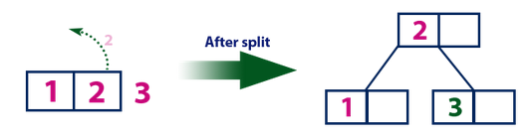
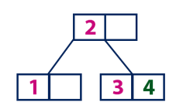
Example 1
B-Tree of Order 3
Max values in a node=n-1=2
Min values in a non-root node=(n-1)/2=(3-1)/2=1
Insert 1
Insert 2
Insert 3
Split
Insert 4

Slide 4
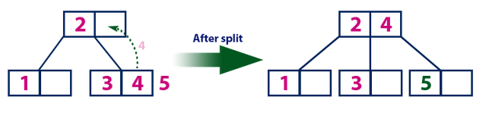
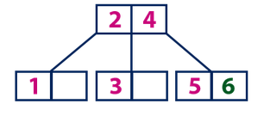
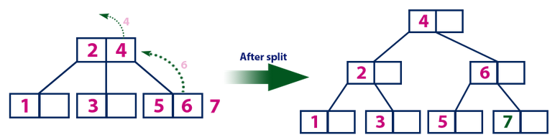
Example 1
Insert 5
Split
Insert 6
Insert 7
Split

Slide 5
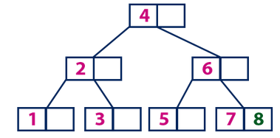
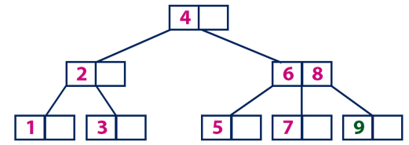
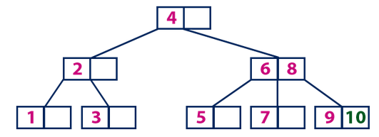
Example 1
Insert 8
Insert 9
Insert 10
Courtesy-http://www.btechsmartclass.com/data_structures/b-trees.html

Slide 6
Example 2
B-Tree of order 4
Each node has at most 4 pointers and 3 keys, and at least 2 pointers and 1 key.
Using Right bias
Insert: 5, 3, 21, 9, 1, 13, 2, 7, 10, 12, 4, 8

Slide 7
Insert 5, 3, 21
* 5 *
a
* 3 * 5 *
a
* 3 * 5 * 21 *
a

Slide 8
Insert 9
* 9 *
a
b
c
* 3 * 5 *
* 21 *
Node a splits creating 2 children: b and c

Slide 9
Insert 1, 13
* 9 *
a
b
c
* 1 * 3 * 5 *
* 13 * 21 *
Nodes b and c have room to insert more elements

Slide 10
Insert 2
* 3 * 9 *
a
b
d
c
* 1 * 2 *
* 5 *
* 13 * 21 *
Node b has no more room, so it splits creating node d.

Slide 11
Insert 7, 10
* 3 * 9 *
a
b
d
c
* 1 * 2 *
* 5 * 7 *
* 10 * 13 * 21 *
Nodes d and c have room to add more elements

Slide 12
Insert 12
* 3 * 9 * 13 *
a
b
d
c
e
* 1 * 2 *
* 5 * 7 *
* 10 * 12 *
* 21 *
Nodes c must split into nodes c and e

Slide 13
Insert 4
a
* 3 * 9 * 13 *
b
d
c
e
* 1 * 2 *
* 4 * 5 * 7 *
* 10 * 12 *
* 21 *
Node d has room for another element

Slide 14
Insert 8
a
* 9 *
f
g
* 3 * 7 *
* 13 *
b
d
h
c
e
* 1 * 2 *
* 4 * 5 *
* 8 *
* 10 * 12 *
* 21 *
Node d must split into 2 nodes. This causes node a to split into 2 nodes and the tree grows a level.

Slide 15
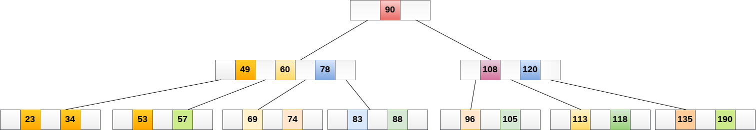
Example 3 Delete 57

Slide 16
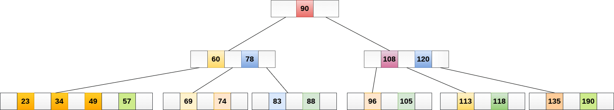
Example 3 Delete 57

Slide 17
Delete 43,80,18,50 consecutively from the following tree of Order 5
Example 4
* 50 *
* 20 * 40 *
* 70 * 100*
* 60 * 65*
*110 *140*170*200
* 4 * 18 *
* 22 * 36 *
* 41 * 43*48*
* 80 *95*

Slide 18
Delete 43
Example 4
* 50 *
* 20 * 40 *
* 70 * 100*
* 60 * 65*
*110 *140*170*200
* 4 * 18 *
* 22 * 36 *
* 41 * 43*48*
* 80 *95*

Slide 19
Delete 80
Example 4
* 50 *
110
* 20 * 40 *
* 70 * 100*
* 60 * 65*
*110 *140*170*200
100
* 4 * 18 *
* 22 * 36 *
* 41 * 48*
* 80 *95*

Slide 20
Delete 80
Example 4
* 50 *
* 20 * 40 *
* 70 * 110*
* 60 * 65*
*140*170*200
* 4 * 18 *
* 22 * 36 *
* 41 * 48*
*95* 100*

Slide 21
Example 5
Inorder EACKFHDBG
Preorder FAEKCDHGB
Create Binary Tree

Slide 22
Example 5
Inorder EACKFHDBG=LNR
Preorder FAEKC DHGB=NLR
Preorder left subtree=AEKC
Root Node of Left Subtree=A
Preorder Right Subtree=DHGB
Root Node of Right Subtree=D
F
F
A
D

Slide 23
Example 5
Inorder EACKFHDBG=LNR
Preorder FAEKC DHGB=NLR
Inorder of Left Subtree=EACK
Left child of A=E
Right subtree of A=CK
Inorder of Right Subtree=HDBG
Left child of D=H
Right subtree of D=BG
F
A
D
F
A
D
E
H

Slide 24
Example 5
Inorder EACKFHDBG=LNR
Preorder FAEKC DHGB=NLR
Preorder=KC
Root=K
Preorder=GB
Root=G
Inorder=CK
Left child of K=C
Inorder=BG
Left child of G=B
F
A
D
E
K
H
G
C
B

Slide 25
Example 6
Draw expression tree for 3 + ((5+9)*2)

Slide 26
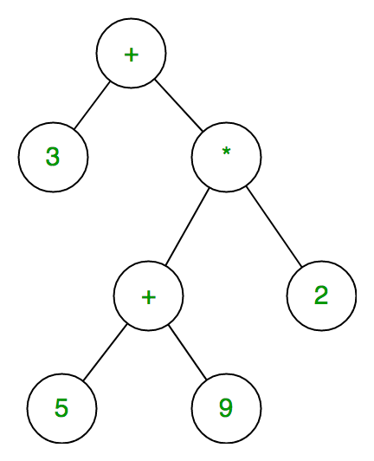
Example 6
Each internal node corresponds to the operator
Each leaf node corresponds to the operand
3 + ((5+9)*2)

